Slide 1

The Color Pursuit

Slide 2
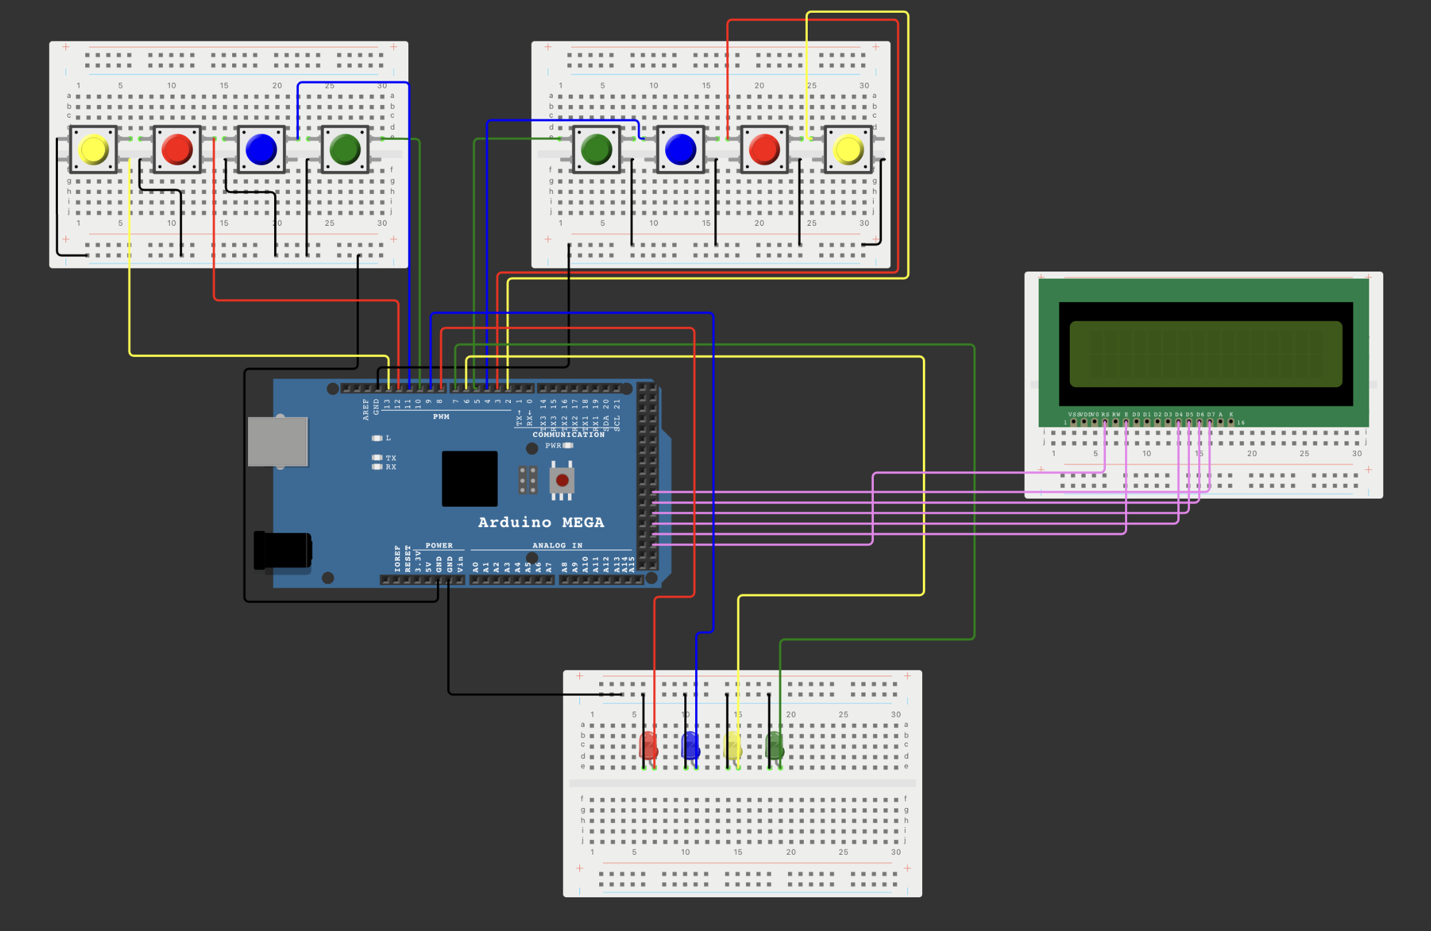
The Color Pursuit Arduino Game
It is a competitive game where points are earned by remembering consecutive randomly lit led lamps in the correct order.

Slide 3
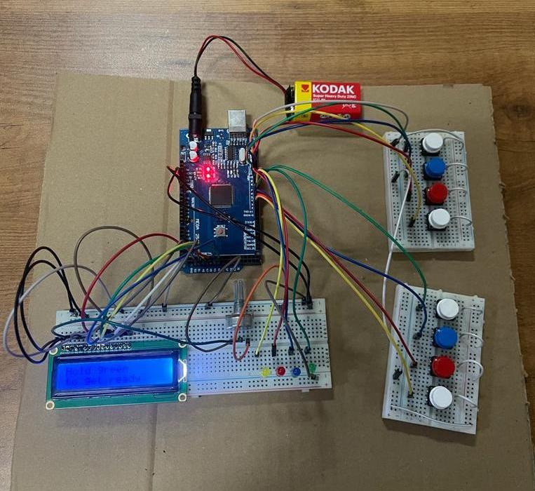
Electronic Materials used in project
Arduino Mega
LED x4
Breadboard
LCD Screen
Button x8
Jumper

Slide 4
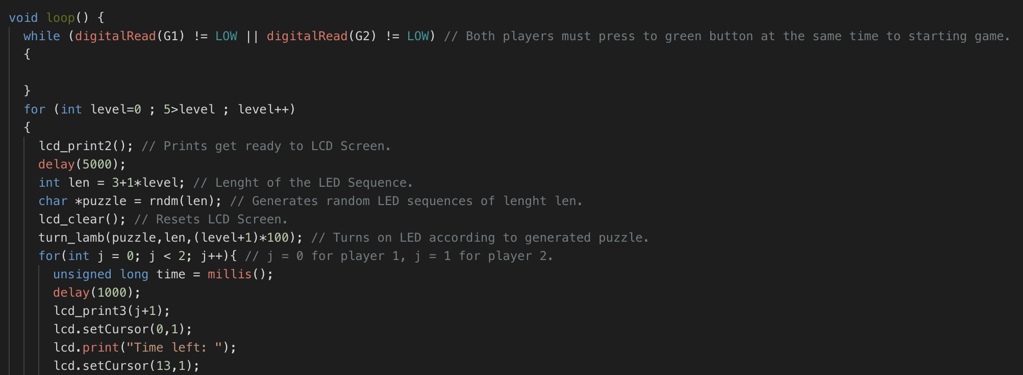
Explanation of Arduino Code (Part 1)

Slide 5
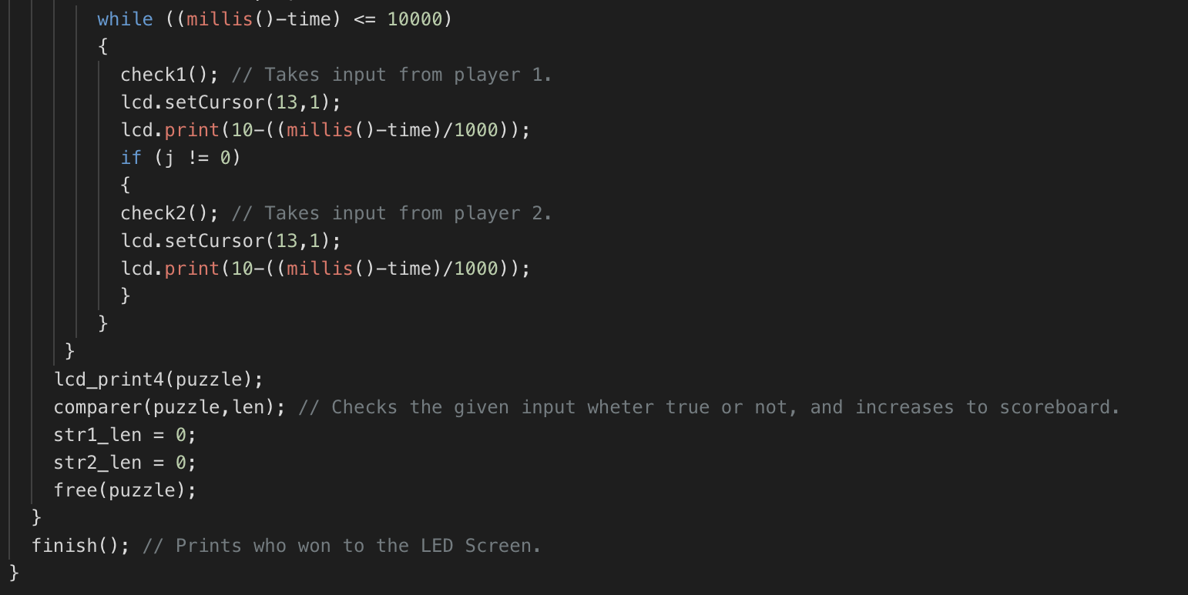
Explanation of Arduino Code (Part 2)

Slide 6
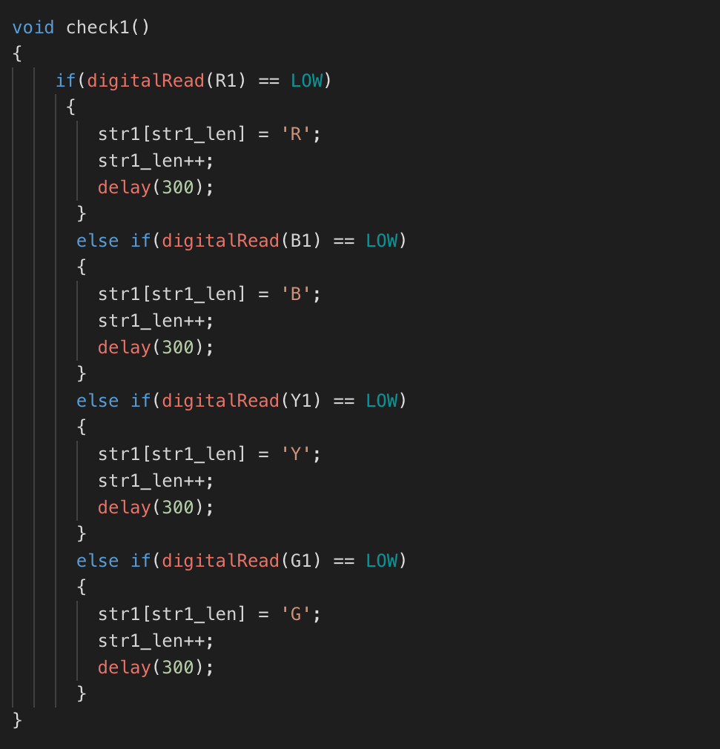
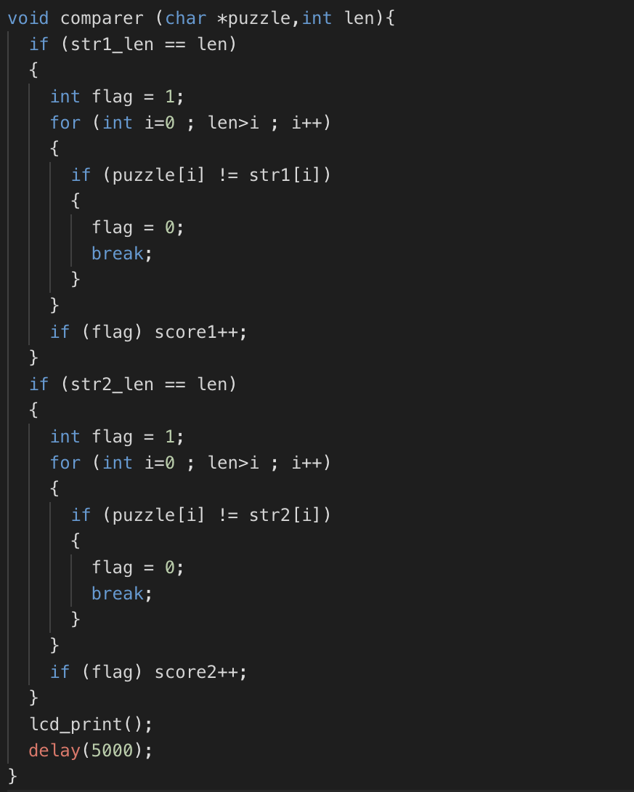
Explanation of Arduino Code (Part 3)

Slide 7
Group 6
Hakan Ata Yılmaz
Bedri Kutay Karaman
Arda Yasan
Burak Kuruçay
Barış Eren Gezici
Şerif Naşid
Sedef Köroğlu
Muhammed Bilal Türk
Ömer Faruk Gürsel

